Slide 1
Agenda
Feedback on previous assignment.
Lecture, Q & A, discussion – Writing an Effective Cover Letter and Resume
Cover Letter and Resume Assignment

Slide 2

Learning Objectives
Review and use key information listed on job postings in your marketing materials
Review format and content requirements for a professional cover letter and resume
Recognize areas in need of updating, and provide suggestions on how to improve marketing materials
Create a professional targeted cover letter
Create a professional resume using vMock
NEXT

Slide 3

Week 4 & 5
Writing an Effective Resume & Cover Letter
JSS-1001 JOB SEARCH & SUCCESS
NEXT

Slide 4
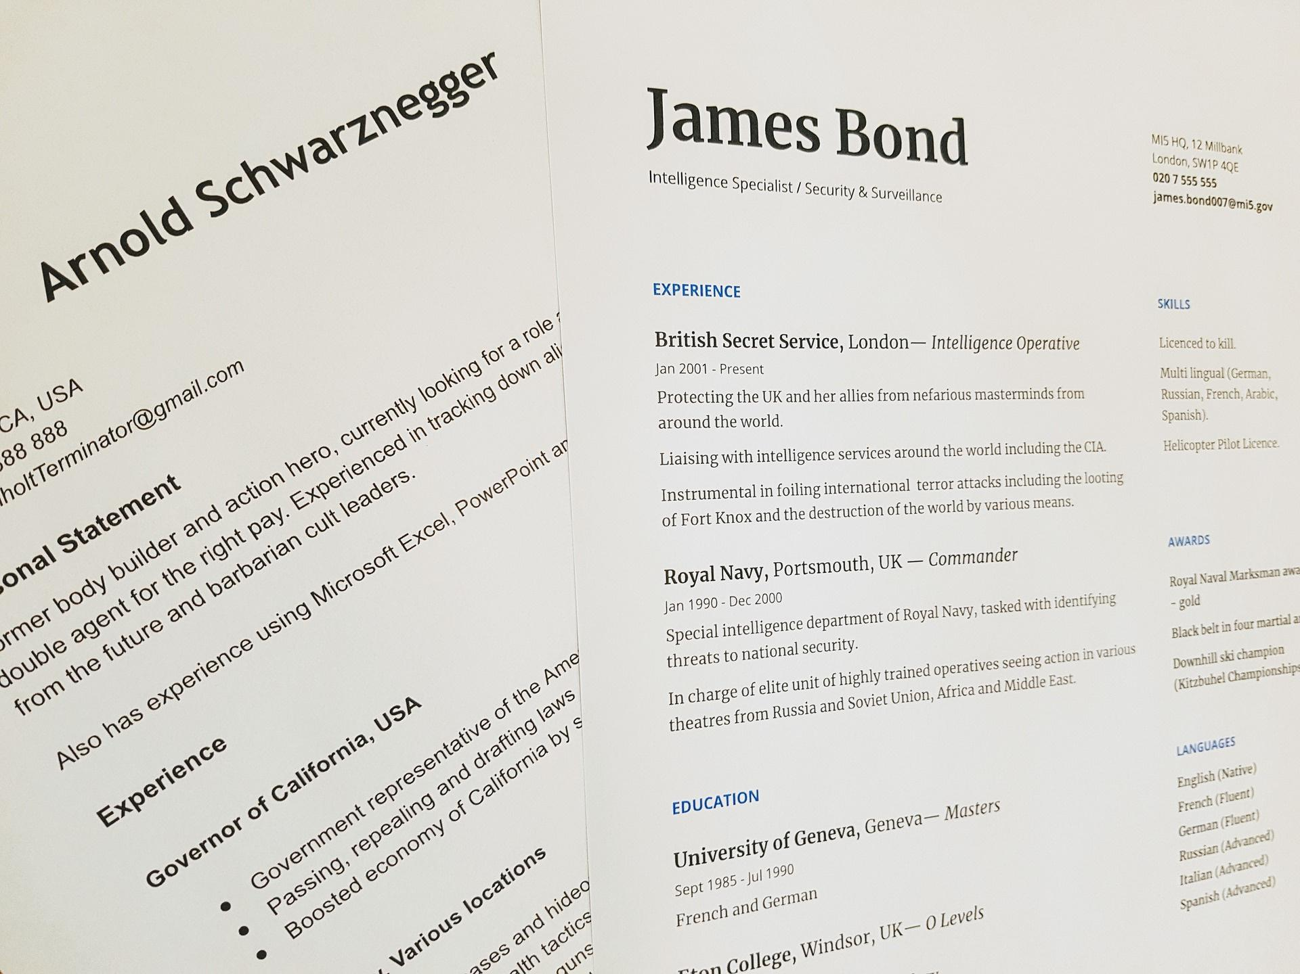
REVIEW AND USE KEY INFORMATION LISTED IN JOB POSTINGS IN YOUR MARKETING MATERIALS
NEXT

Slide 5






Identifying Key Words in a Job Posting
Search online for a job posting of your interest and consider the following:
What skills and qualifications are they looking for?
Do these skills match your skills?
What can you do to develop these skills?
NEXT

Slide 6

The Importance of Reading the Job Posting
Read the job description and then read it again!
Look for keywords
On average, job seekers spend 76 seconds reading a job description.
Which may be the reason why hiring managers find that 50% of applicants fail to demonstrate qualification for the job
Adopted from (zety.com/blog/resume-tips)
NEXT

Slide 7
A Few Words from Local Hiring Managers
"I often review a 100+ resumes when hiring for a position so I look for marketing materials that stand out. I am not interested in standard claims such as "strong customer service skills", "great communication skills" etc. I am looking to gain insight from the resume. I look for an interesting and fresh layout, strong skill statements and a mention of my organization."
Local Hiring Manager, Sarnia, ON
"Please stay away from submitting a resume listing "stock" skills. This doesn't allow us to get to know more about you, and it doesn't allow you to showcase how your skills and qualifications align with our organizational needs. Look for creative ways to stand out from your competition!"
Local Hiring Manager, Sarnia, ON
NEXT

Slide 8

It is time to take your cover letter and resume to the next level!
NEXT

Slide 9

Cover Letter
NEXT

Slide 10
Cover Letter - Introduction Section
The purpose of your letter, what are you applying for?
Example: Please consider my application for the position of ______ advertised at _____ on ____date
OR
Please consider my application for any part-time positions that come available at _________
NEXT

Slide 11
Cover Letter - Education Section
What have you gained from post-secondary education that qualifies you related to the position?
Example:
Currently enrolled in ________ at Lambton College through which I have gained a solid working knowledge of.......
NEXT

Slide 12
Cover Letter - Experience & Skills Section
What specific experience and skills have you gained from work, volunteering, other activities that qualify you for the position?
Example:
While working as a Customer Service Representative at BMO I developed excellent interpersonal skills and was able to manage clients' problems and offer effective solutions........
NEXT

Slide 13
Cover Letter - Closing Section
Thank the reader, request interest in an interview and include contact information.
Example:
Thank you for reviewing my resume. I look forward to hearing from you to further discuss my qualifications at an interview. I can be reached at _______ or via email at ________.
NEXT

Slide 14
Time to Review your Cover Letter
Do you need to make any adjustments to your cover letter?
NEXT

Slide 15

Resume Sections - Review
Important Resume Content:
Education
Skills & Qualifications (list GPA if impressive, awards, scholarships etc.)
Highlight your potentials
Summarize your achievements
How you stand out from others - what makes you unique
How you have what the employer is looking for
Be prepared to back up any claim or statement in an interview
NEXT

Slide 16
Take your Resume from Good to Great!
Focus on skills NOT duties
NEXT

Slide 17
Take your Resume from Good to Great!
Example: Customer Service Rep at a Call Centre
Duties
- what you are expected to do in a job
Examples of Skills
Communication skills
Customer service
Problem solving
Patience
Product knowledge
Attention to detail
Confidentiality
Completed required training
Answered incoming calls
Provided customer service
Handled upset customers
Resolved customer account issues
Documented interaction with customers
What did you do + How did you do it + What was the result = Skill Statement
NEXT

Slide 18
Work Experience
Utilized effective communication skills to provide above average customer service to new and existing customers
Addressed customer service inquiries in a timely and professional fashion
Provided accurate and appropriate information in response to customer inquiries
Made rational procedure exceptions to accommodate unusual customer requests to ensure customer satisfaction, following company policy
Consistently achieved customer satisfaction rating of 95% six consecutive months, exceeding corporate targets
Actively participated in team meetings and engaged in corporate social/team building event
What did you do + How did you do it + What was the result = Skill Statement
NEXT

Slide 19


Resume Challenges
Develop skill statements that provide insight, details and proof!
Well-developed statements:
"Achieved a satisfaction rating of 99% by initiating a follow up system with customers indicating their business was valued"
"Supported over 50 customers daily, identifying and successfully fulfilling their needs by troubleshooting, leading to increased customer satisfaction"
Basic statements:
"Strong customer service skills"
or
"Responsible for providing excellent customer service"
NEXT

Slide 20
Resume Challenges
Develop skill statements that provide insight and details
Basic statements:
"Responsible for sales"
"Completed safety training"
Well-developed statements:
"Increased sales by 10% over a period of 6 months"
"Completed an online training program offered through the Ministry of Labour. Passed three modules demonstrating knowledge of safety precautions in the workplace
NEXT

Slide 21
Work Experience - What Should be Included?
Resume Content Should Include:
Relevant and related to the job you are applying for (previous co-op, placement, work, volunteer work
Other Experiences and opportunities related to the posting from where you gain skills and experience
Volunteer Experiences (current, ongoing, or recent)
NEXT

Slide 22

What has COVID-19 Taught Us?
Well, many things, but certainly new skills! More than ever, employers may be looking for (no matter what industry):
Ability to be effective and efficient in various environments and are confident in your decision-making ability
Ability to think creatively and develop new and innovative solutions in situations of rapid change
Ability to stay composed and be successful when faced with unexpected challenges and rapid change
Ability to adjust and be flexible when new opportunities are presented to you
Ability to learn new things quickly and aren't afraid to try new ways of doing things
Adapted from: (Vulkov, 2021) https://enhancv.com/resume-skills/adaptability/
NEXT

Slide 23

Cover Letter and Resume Tips!
Tailor your marketing materials to the job description
King Tip of All Tips!
NEXT

Slide 24
Cover Letter and Resume Tips!
Highlight key qualifications and skills on the job posting and highlight how these are addressed in your cover letter and resume.
If you can't find evidence of of the required skills in your marketing materials, you are not done!
NEXT

Slide 25

Additional Cover Letter and Resume Tips!
Name you marketing files professionally (avoid resume v113, resume, newresume etc.
Make it easy for the recruiter to find your marketing materials (i.e., John Smith Resume)
Ensure cohesiveness between your cover letter and resume (tell the same story)
Use a word cloud generator for the job description, cover letter and resume and look for matches
NEXT

Slide 26
Cover Letter and Resume Tips!
Cover Letter Check List: https://www.mylambton.ca/docs/default-source/co-op-career-services/co-op-and-career-services---checklist---coverletter.pdf?sfvrsn=6e2cdb0e_2
Cover Letter Sample Letter: https://www.mylambton.ca/docs/default-source/co-op-career-services/co-op-and-career-services---sample-cover-letter.pdf?sfvrsn=36f2ff8f_2
Resume Checklist: https://www.mylambton.ca/docs/default-source/co-op-career-services/co-op-and-career-services---checklist---resume.pdf?sfvrsn=7e1d7843_2
Resume Sample: https://www.mylambton.ca/docs/default-source/co-op-career-services/co-op-and-career-services---sample-resume.pdf?sfvrsn=b456d971_2
NEXT

Slide 27
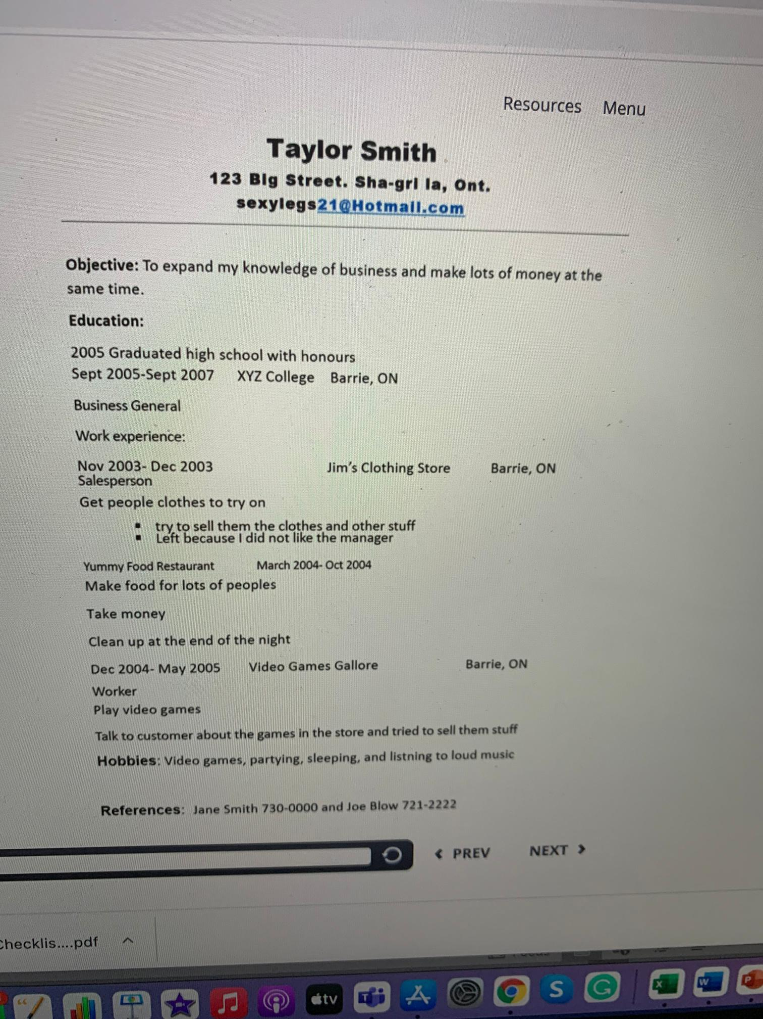
What would you Change?

Slide 28
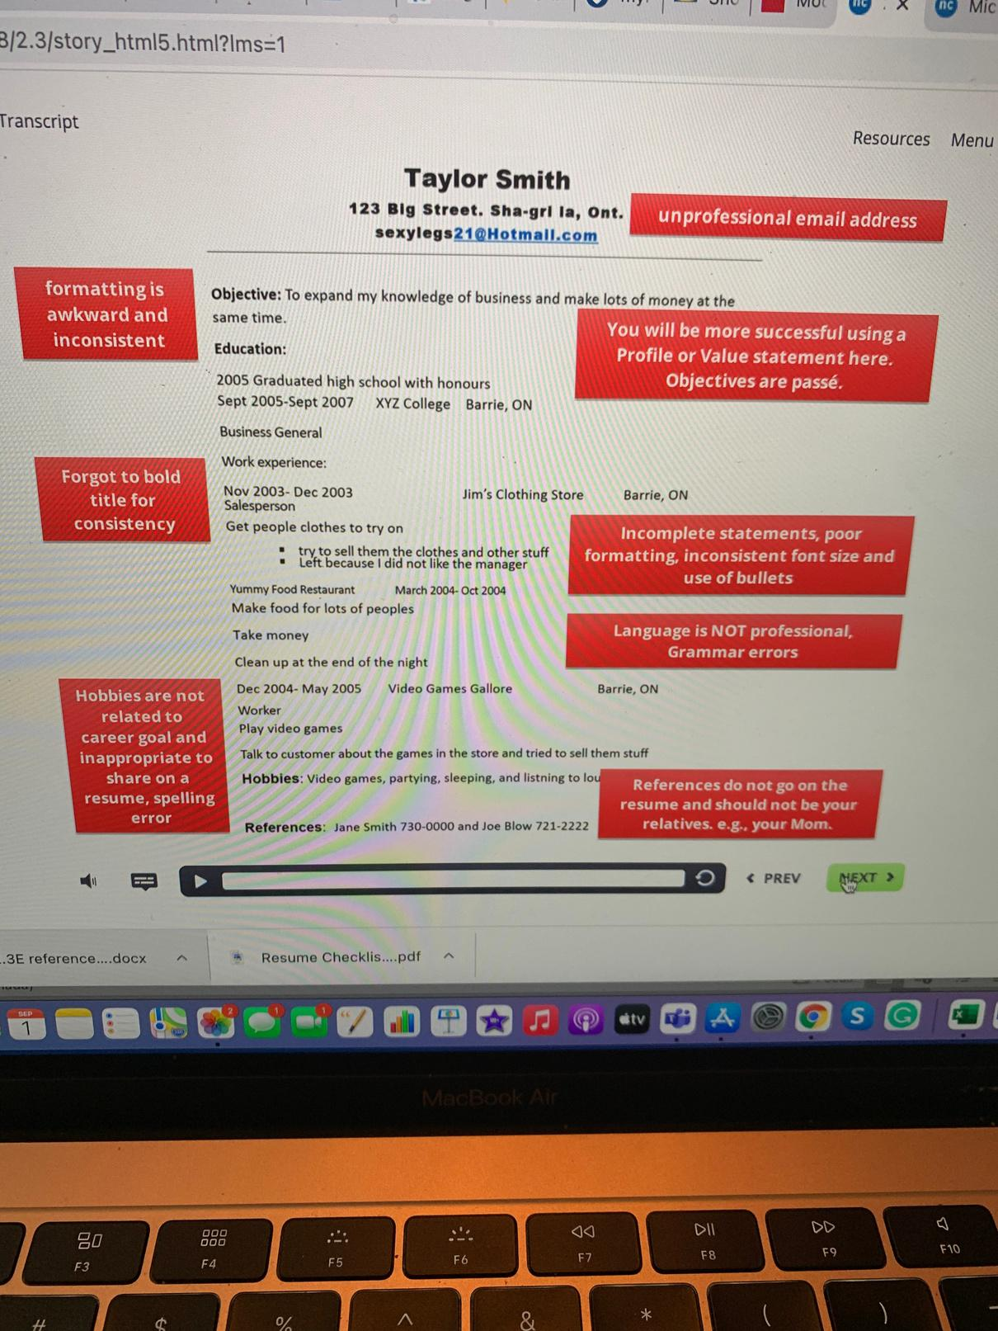
Let's Review

Slide 29
Taking your Marketing Materials from Good to Great!
Is it time to make some adjustments and updates to your resume?
NEXT

Slide 30
vMock Resume Module
NEXT

Slide 31

VMock, is a 24-7 online resume-review tool, that leverages data-science, machine learning, and natural language processing to provide instant personalized feedback on your resume based on criteria gathered from employers and global best practices.
https://www.vmock.com/video

Slide 32
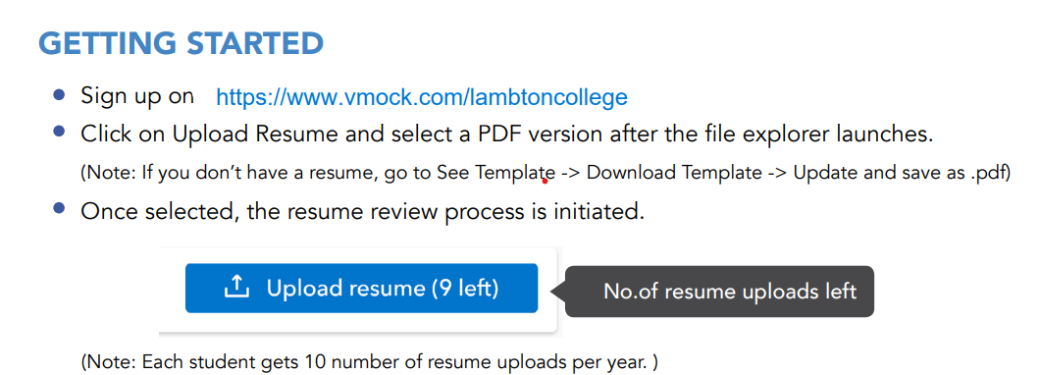

Slide 33
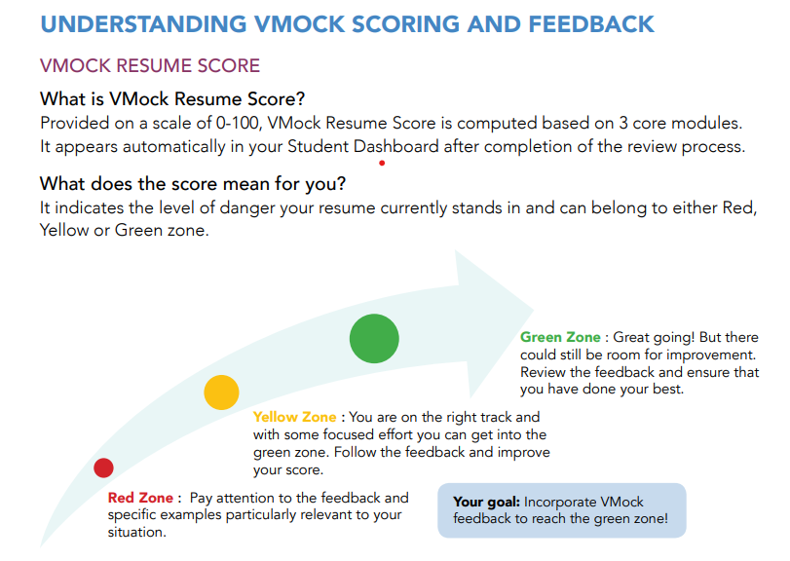

Slide 34
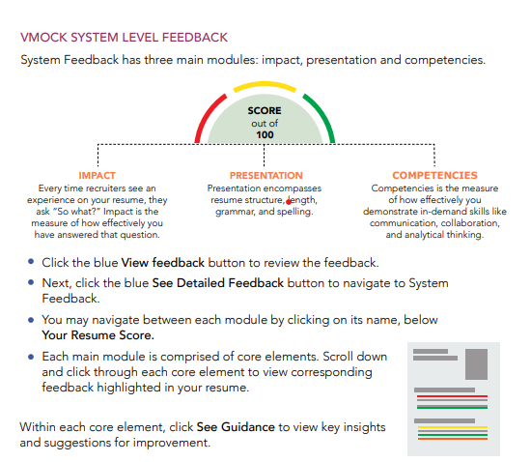

Slide 35


Explore vMock
In-class Activity
35 min.

Slide 36

Explore vMock In-Class Activity
Take the remainder of today’s class time to explore vMock.
Play around with the features and explore!
Upload your current resume and read the feedback.

Slide 37
Cover Letter and Resume Assignment (20%)

Slide 38
Cover Letter & Resume Assignment Outline & Marking Criteria (20%)
Objective: Update your cover letter and resume to ensure you are ready to stand out from the crowd!
Instructions: Find a job posting relevant to your study area. Create a cover letter and a resume to target that job posting, as if you were applying for that specific job.
Part 1: Cover letter
Write a cover letter that targets the specific job posting. Please use the content covered in this unit to create your cover letter.
Part 2: Resume
Use VMock (refer to instructions within the course) to create your updated and polished resume. A score and feedback will be provided to you in vMock. You can make updates and re-submit again through vMock to update your feedback and improve your resume and your score. Students have 8 attempts to create a resume that has a score of a minimum of 70%. Once you have obtained the 70% score, take a copy or a screenshot of the report, and add it to the Resume Assignment link in Moodle, with a copy of the resume you created.
Submission Instructions: Upload the job posting, cover letter, resume and a screenshot of your vMock resume final score to the specified Moodle Assignment link by the required deadline.

Slide 39
Cover Letter & Resume Assignment Outline & Marking Criteria (20%)
Marking Criteria: Cover Letter
Marking Criteria: Resume
Format:
Follows format outlined in class, creative and stands out
/2
Format:
Follows format outlined in class, creative and stands out
/4
Content:
3-4 paragraphs including (intro, education, experience & closing)
/3
Content:
Professional, well-developed skills statements, uses bullets/point form
/8
Targeted:
Accomplishment statements/proof of qualification
/3
Targeted:
Specific to job posting, highlighting transferrable skills
/4
Overall Appearance/Marketability:
Answers why should I hire you
/2
Overall Appearance/Marketability:
Answers why should I hire you, creative layout and polished look and feel
/4
Deductions:
Spelling/gramma concerns, fails to demonstrate up-to-date
Deductions:
Spelling/gramma concerns, fails to demonstrate up-to-date
Marking Criteria: vMock Score
/10
/20
TOTAL SCORE
/40
vMock Score:
vMock Score is at least over 70%
/10

